Slide 1

7th Grade Math
Unit 10, Lesson 7 Solving Equations Involving the Distributive Property Volume 2, pg. 122

Slide 2


Benchmark
MA.7.AR.2.2
Write and solve two-step equations in one variable within a mathematical context or real-world context, where all terms are rational numbers.
volume 1, pg. 122

Slide 3
Integrated Mathematical Thinking and Reasoning Standards
MA.K12.MTR.1.1 Actively participate in effortful learning both individually and collectively.
MA.K12.MTR.2.1 Demonstrate understanding by representing problems in multiple ways.
MA.K12.MTR.3.1 Complete tasks with mathematical fluency.
MA.K12.MTR.4.1 Engage in discussions that reflect on the mathematical thinking of self and others.
MA.K12.MTR.5.1 Use patterns and structure to help understand and connect mathematical concepts.
volume 1, pg. 122

Slide 4

Learning Target
I can solve two-step equations involving the distributive property.
volume 1, pg. 122

Slide 5

Warm-Up
volume 1, pg. 123

Slide 6

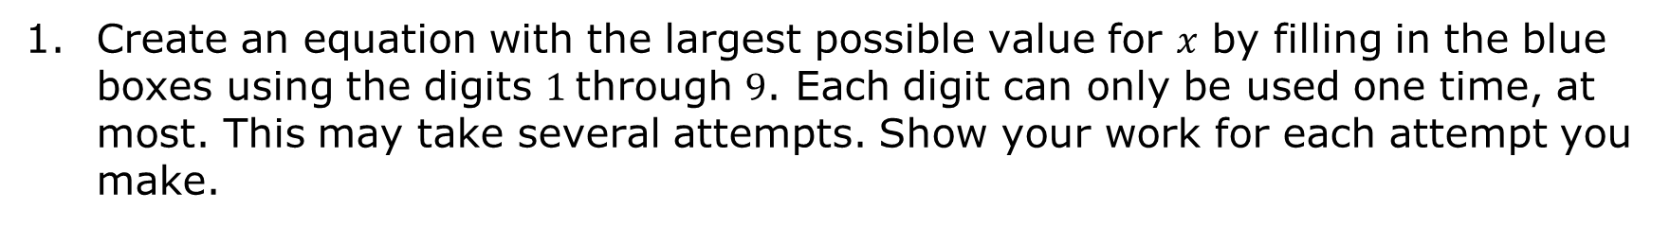
10.7.1 Warm-Up: Two-Step Equations
Create an equation with the largest possible value for $x$ by filling in the blue boxes using the digits $1$through $9$. Each digit can only be used one time, at most. This may take several attempts. Show your work for each attempt you make.
volume 1, pg. 123

Slide 7

Refresher
volume 1, pg. 123

Slide 8

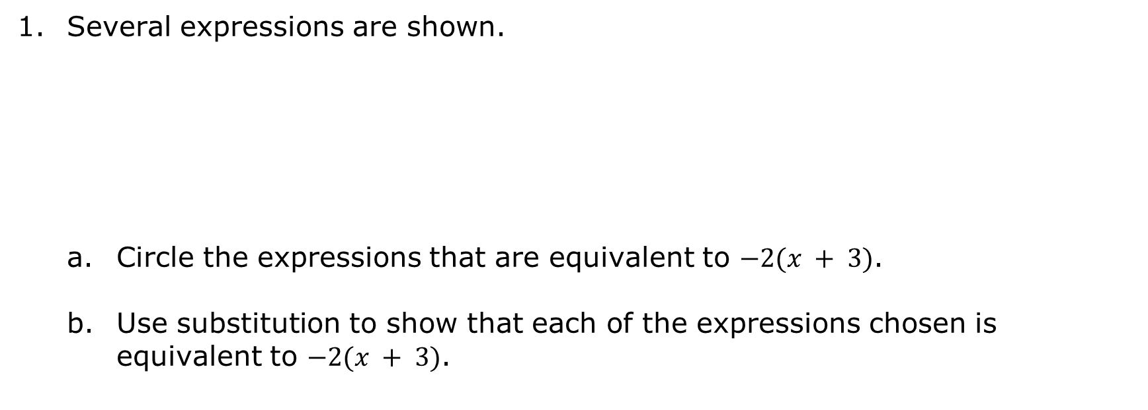
10.7.2 Refresher: The Distributive Property
Several expressions are shown.
Circle the expressions that are equivalent to $−2(x + 3)$.
Use substitution to show that each of the expressions chosen is equivalent to $−2(x + 3)$.
$$(−2⋅x)+3$$ | $$\left(x+3\right)(−2)$$ | $$−2x−6$$
$$(−2)⋅x+(−2)⋅3$$ | $$\left(−2+x\right)3$$
volume 1, pg. 123

Slide 9

Rewrite each expression by applying the distributive property.
a. $\left(−x + 6\right)4$
b. $−3.5\left(−7 + 2y\right)$
c. $\frac{7}{8}\left(16m−\frac{4}{5}\right)$
volume 1, pg. 123

Slide 10

Collaboration
volume 1, pg. 124

Slide 11

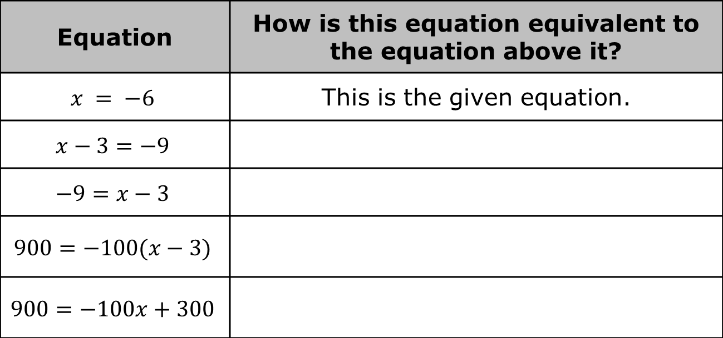
10.7.3 Collaboration: Equivalent Equations
All of the equations in the table below are equivalent. Work with your partner to explain how each equation is equivalent to the previous equation.
Equation | How is this equation equivalent to the equation above it?
$$x = −6$$ | This is the given equation.
$$x−3=−9$$
$$−9=x−3$$
$$900=−100(x−3)$$
$$900=−100x+300$$
volume 1, pg. 124

Slide 12
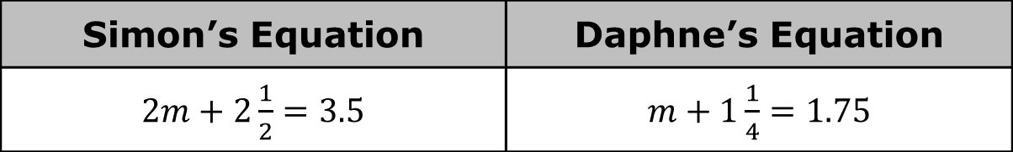

Two students wrote equations equivalent to $2\left(m+1\frac{1}{4}\right)=3.5$.
Describe what Simon did to generate his equivalent equation.
Describe what Daphne did to generate her equivalent equation.
Simon’s Equation | Daphne’s Equation
$2m+2\frac{1}{2}=3.5$ | $m+1\frac{1}{4}=1.75$
volume 1, pg. 124

Slide 13

Guided Instruction
volume 1, pg. 125

Slide 14
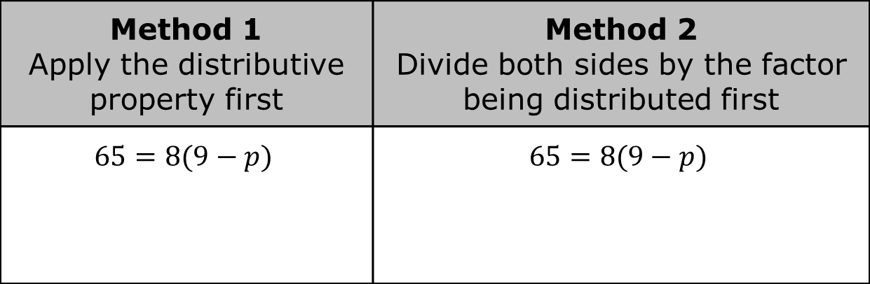
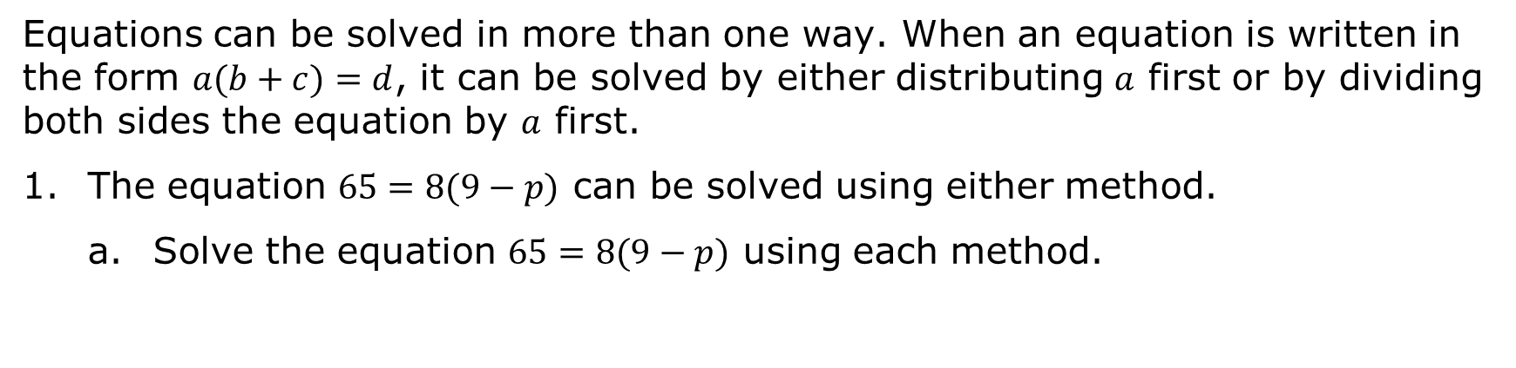
10.7.4 Guided Instruction: Solving Equations Involving the Distributive Property
Equations can be solved in more than one way. When an equation is written in the form $a(b+c)=d$, it can be solved by either distributing $a$ first or by dividing both sides the equation by $a$ first.
The equation $65=8(9−p)$ can be solved using either method.
Solve the equation $65=8(9−p)$ using each method.
Method 1 Apply the distributive property first | Method 2 Divide both sides by the factor being distributed first
$$65=8(9−p)$$ | $$65=8(9−p)$$
volume 1, pg. 125

Slide 15
Verify the solution is correct using substitution.
Discuss each method of solving the equation with your partner. Then, explain which method you preferred for solving this equation.
volume 1, pg. 125

Slide 16
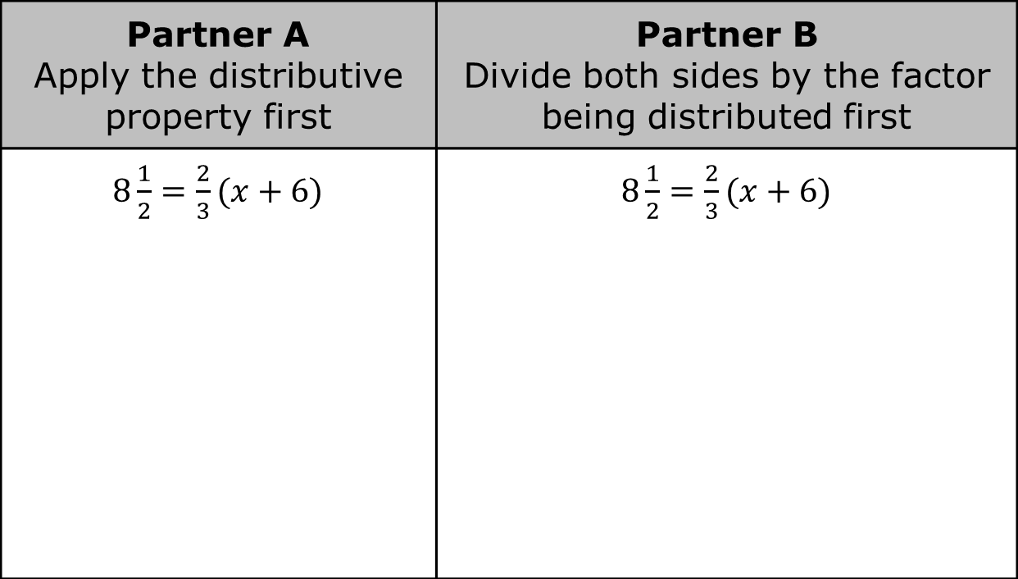
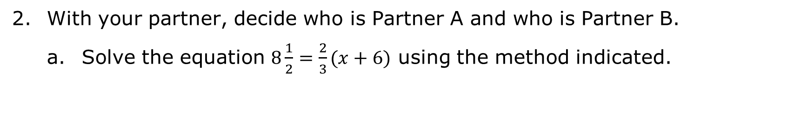
With your partner, decide who is Partner A and who is Partner B.
Solve the equation $8\frac{1}{2}=\frac{2}{3}(x+6)$ using the method indicated.
Partner A Apply the distributive property first | Partner B Divide both sides by the factor being distributed first
$8\frac{1}{2}=\frac{2}{3}(x+6)$ | $8\frac{1}{2}=\frac{2}{3}(x+6)$
volume 1, pg. 126

Slide 17
Share your solution and your work with your partner. Correct any errors, if necessary. Then, write your partner’s method in the space provided once both partners agree the work is correct.
Explain which method you preferred for solving this equation.
volume 1, pg. 126

Slide 18
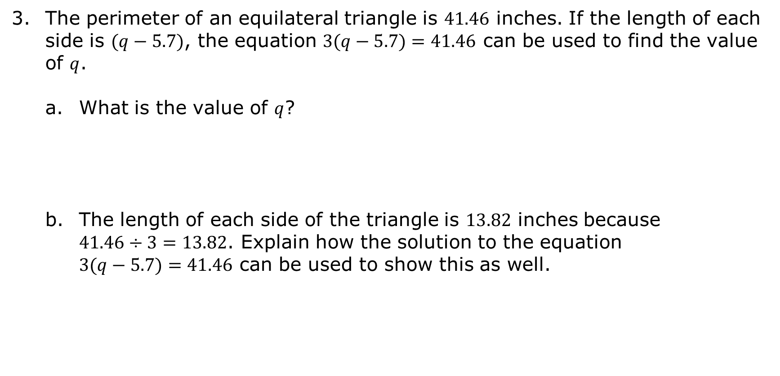
The perimeter of an equilateral triangle is $41.46$ inches. If the length of each side is $(q−5.7)$, the equation $3(q−5.7)=41.46$ can be used to find the value of $q$.
What is the value of $q$?
The length of each side of the triangle is $13.82$ inches because $41.46÷3=13.82$. Explain how the solution to the equation $3(q−5.7)=41.46$ can be used to show this as well.
volume 1, pg. 126

Slide 19

Guided Practice
volume 1, pg. 127

Slide 20


10.7.5 Guided Practice: Solving Equations Involving the Distributive Property
Solve each equation using your preferred method. Then, verify that your solution is correct using substitution.
1. $\frac{3}{4}\left(k−5\frac{1}{2}\right)=\frac{5}{8}$
2. $−3=(w−1.7)(−10)$
volume 1, pg. 127

Slide 21
Collaboration
volume 1, pg. 127

Slide 22

10.7.6 Collaboration: Error Analysis
Work with your partner to complete the following.
Francesca was asked to solve the equation $−4\frac{1}{2}=\frac{1}{3}\left(x−1.5\right)$. Her work is shown.
$−4\frac{1}{2}=\frac{1}{3}\left(x−1.5\right)$
$−4.5+1.5=\frac{1}{3}\left(x−1.5\right)+1.5$
$−2=\frac{1}{3}x$
$\frac{−2}{\frac{1}{3}}=\frac{\frac{1}{3}x}{\frac{1}{3}}$
$$x=−6$$
volume 1, pg. 127

Slide 23
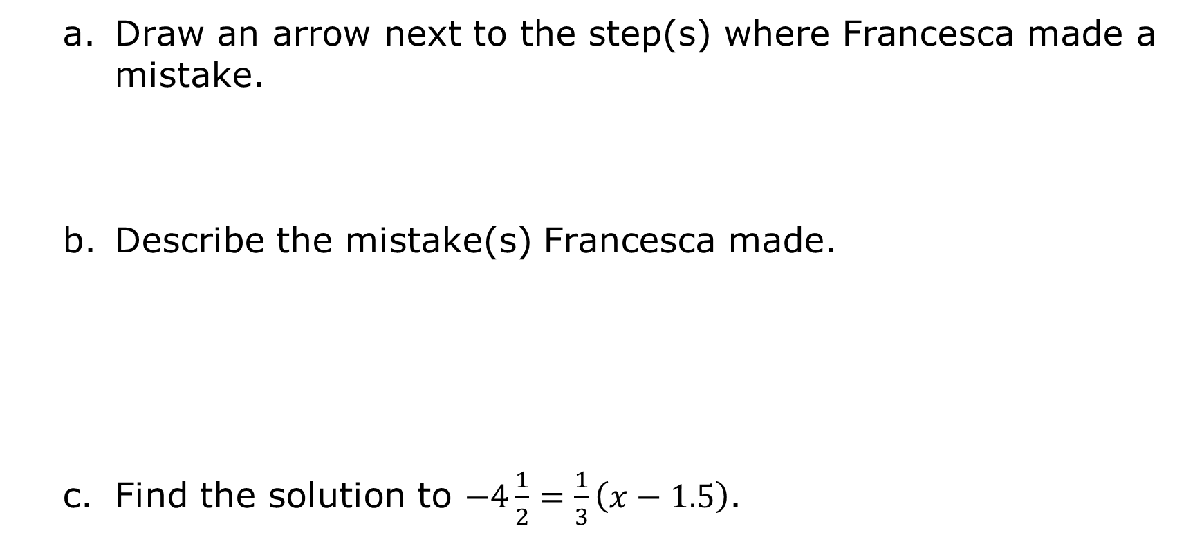
Draw an arrow next to the step(s) where Francesca made a mistake.
Describe the mistake(s) Francesca made.
Find the solution to $−4\frac{1}{2}=\frac{1}{3}\left(x−1.5\right)$.
volume 1, pg. 127

Slide 24

Wrap-Up
volume 1, pg. 128

Slide 25
10.7.7 Wrap-Up: Ticket Out the Door
Solve $5\left(x+\frac{2}{5}\right) = {}_{}^{−}{13}$.
volume 1, pg. 128

